Slide 1
Module 2: Basic Switch and End Device Configuration (Cont.)
Instructor Materials
Introduction to Networks v7.0 (ITN)
Notes:
Cisco Networking Academy Program
CCNA 1
Module 2: Basic Switch and End Device Configuration

Slide 2
2.4 Basic Device Configuration
Notes:
2 – Basic Switch and End Device Configuration
2.4 – Basic Device Configuration

Slide 3
Basic Device Configuration Device Names
The first configuration command on any device should be to give it a unique hostname.
By default, all devices are assigned a factory default name. For example, a Cisco IOS switch is "Switch.”
Guideline for naming devices:
Start with a letter
Contain no spaces
End with a letter or digit
Use only letters, digits, and dashes
Be less than 64 characters in length
Note: To return the switch to the default prompt, use the no hostname global config command.
Notes:
2 – Basic Switch and End Device Configuration
2.4 – Basic Device Configuration
2.4.1 – Device Names

Slide 4

Basic Device Configuration Password Guidelines
The use of weak or easily guessed passwords are a security concern.
All networking devices should limit administrative access by securing privileged EXEC, user EXEC, and remote Telnet access with passwords. In addition, all passwords should be encrypted and legal notifications provided.
Password Guidelines:
Use passwords that are more than eight characters in length.
Use a combination of upper and lowercase letters, numbers, special characters, and/or numeric sequences.
Avoid using the same password for all devices.
Do not use common words because they are easily guessed.
Note: Most of the labs in this course use simple passwords such as cisco or class. These passwords are considered weak and easily guessable and should be avoided in production environments.
Notes:
2 – Basic Switch and End Device Configuration
2.4 – Basic Device Configuration
2.4.2 – Password Guidelines

Slide 5
Basic Device Configuration Configure Passwords
Securing user EXEC mode access:
First enter line console configuration mode using the line console 0 command in global configuration mode.
Next, specify the user EXEC mode password using the password password command.
Finally, enable user EXEC access using the login command.
Securing privileged EXEC mode access:
First enter global configuration mode.
Next, use the enable secret password command.
Notes:
2 – Basic Switch and End Device Configuration
2.4 – Basic Device Configuration
2.4.3 – Configure Passwords

Slide 6
Basic Device Configuration Configure Passwords (Cont.)
Securing VTY line access:
First enter line VTY configuration mode using the line vty 0 15 command in global configuration mode.
Next, specify the VTY password using the password password command.
Finally, enable VTY access using the login command.
Note: VTY lines enable remote access using Telnet or SSH to the device. Many Cisco switches support up to 16 VTY lines that are numbered 0 to 15.
Notes:
2 – Basic Switch and End Device Configuration
2.4 – Basic Device Configuration
2.4.3 – Configure Passwords

Slide 7
Basic Device Configuration Encrypt Passwords
The startup-config and running-config files display most passwords in plaintext.
To encrypt all plaintext passwords, use the service password-encryption global config command.
Use the show running-config command to verify that the passwords on the device are now encrypted.
Notes:
2 – Basic Switch and End Device Configuration
2.4 – Basic Device Configuration
2.4.4 – Encrypt Passwords

Slide 8
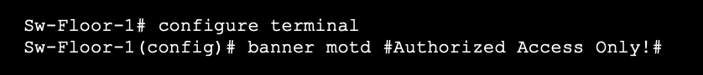
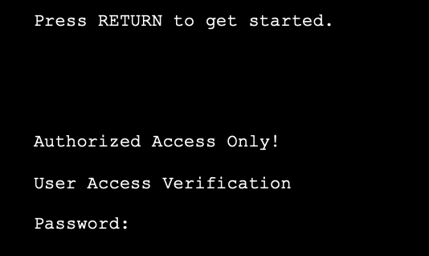
Basic Device Configuration Banner Messages
A banner message is important to warn unauthorized personnel from attempting to access the device.
To create a banner message of the day on a network device, use the banner motd # the message of the day # global config command.
The banner will be displayed on attempts to access the device.
Note: The “#” in the command syntax is called the delimiting character. It is entered before and after the message.
Notes:
2 – Basic Switch and End Device Configuration
2.4 – Basic Device Configuration
2.4.5 – Banner Messages

Slide 9
Basic Device Configuration Video – Secure Administrative Access to a Switch
This video will cover the following:
Access the command line to secure the switch
Secure access to the console port
Secure virtual terminal access for remote access
Encrypt passwords on the switch
Configure the banner message
Verify security changes
Notes:
2 – Basic Switch and End Device Configuration
2.4 – Basic Device Configuration
2.4.6 – Video - Secure Administrative Access to a Switch
2.4.7 – Syntax Checker- Basic Device Configuration
2.4.8 – Check Your Understanding - Basic Device Configuration

Slide 10
2.5 Save Configurations
Notes:
2 – Basic Switch and End Device Configuration
2.5 – Save Configurations

Slide 11
Save Configurations Configuration Files
There are two system files that store the device configuration:
startup-config - This is the saved configuration file that is stored in NVRAM. It contains all the commands that will be used by the device upon startup or reboot. Flash does not lose its contents when the device is powered off.
running-config - This is stored in Random Access Memory (RAM). It reflects the current configuration. Modifying a running configuration affects the operation of a Cisco device immediately. RAM is volatile memory. It loses all of its content when the device is powered off or restarted.
To save changes made to the running configuration to the startup configuration file, use the copy running-config startup-config privileged EXEC mode command.
Notes:
2 – Basic Switch and End Device Configuration
2.5 – Save Configurations
2.5.1 – Configuration Files

Slide 12
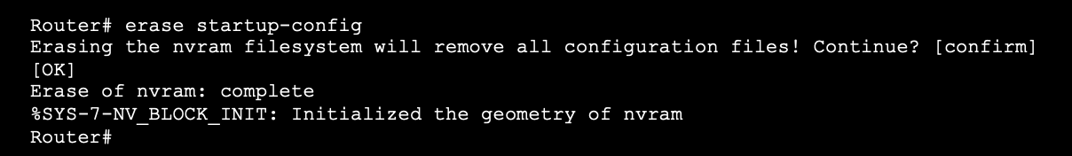
Save Configurations Alter the Running Configurations
If changes made to the running config do not have the desired effect and the running-config has not yet been saved, you can restore the device to its previous configuration. To do this you can:
Remove the changed commands individually.
Reload the device using the reload command in privilege EXEC mode. Note: This will cause the device to briefly go offline, leading to network downtime.
If the undesired changes were saved to the startup-config, it may be necessary to clear all the configurations using the erase startup-config command in privilege EXEC mode.
After erasing the startup-config, reload the device to clear the running-config file from RAM.
Notes:
2 – Basic Switch and End Device Configuration
2.5 – Save Configurations
2.5.2 – Alter the Running Configuration

Slide 13
Save Configurations Video – Alter the Running Configuration
This video will cover the following:
Copy the running-config file to the startup-config file
Show the files in the flash or NVRAM directory
Use command shortening
Erase the startup-config file
Copy the start-config file to the running-config file
Notes:
2 – Basic Switch and End Device Configuration
2.5 – Save Configurations
2.5.3 – Video - Alter the Running Configuration

Slide 14
Save Configurations Capture Configuration to a Text File
Configuration files can also be saved and archived to a text document.
Step 1. Open terminal emulation software, such as PuTTY or Tera Term, that is already connected to a switch.
Step 2. Enable logging in to the terminal software and assign a name and file location to save the log file. The figure displays that All session output will be captured to the file specified (i.e., MySwitchLogs).
Notes:
2 – Basic Switch and End Device Configuration
2.5 – Save Configurations
2.5.4 – Capture Configuration to a Text File

Slide 15

Save Configurations Capture Configuration to a Text File (Cont.)
Step 3. Execute the show running-config or show startup-config command at the privileged EXEC prompt. Text displayed in the terminal window will be placed into the chosen file.
Step 4. Disable logging in the terminal software. The figure shows how to disable logging by choosing the None session logging option
Note: The text file created can be used as a record of how the device is currently implemented. The file could require editing before being used to restore a saved configuration to a device.
Notes:
2 – Basic Switch and End Device Configuration
2.5 – Save Configurations
2.5.4 – Capture Configuration to a Text File

Slide 16
Save Configurations Packet Tracer – Configure Initial Switch Settings
In this Packet Tracer, you will do the following:
Verify the Default Switch Configuration
Configure a Basic Switch Configuration
Configure a MOTD Banner
Save Configuration Files to NVRAM
Configure a second Switch
Notes:
2 – Basic Switch and End Device Configuration
2.5 – Save Configurations
2.5.5 – Packet Tracer – Configure Initial Switch Settings

Slide 17
2.6 Ports and Addresses
Notes:
2 – Basic Switch and End Device Configuration
2.6 – Ports and Addresses

Slide 18
Ports and Addresses IP Addresses
The use of IP addresses is the primary means of enabling devices to locate one another and establish end-to-end communication on the internet.
The structure of an IPv4 address is called dotted decimal notation and is represented by four decimal numbers between 0 and 255.
An IPv4 subnet mask is a 32-bit value that differentiates the network portion of the address from the host portion. Coupled with the IPv4 address, the subnet mask determines to which subnet the device is a member.
The default gateway address is the IP address of the router that the host will use to access remote networks, including the internet.
Notes:
2 – Basic Switch and End Device Configuration
2.6 – Ports and Addresses
2.6.1 – IP Addresses

Slide 19
Ports and Addresses IP Addresses (Cont.)
IPv6 addresses are 128 bits in length and written as a string of hexadecimal values. Every four bits is represented by a single hexadecimal digit; for a total of 32 hexadecimal values. Groups of four hexadecimal digits are separated by a colon “:”.
IPv6 addresses are not case-sensitive and can be written in either lowercase or uppercase.
Note: IP in this course refers to both the IPv4 and IPv6 protocols. IPv6 is the most recent version of IP and is replacing the more common IPv4.
Notes:
2 – Basic Switch and End Device Configuration
2.6 – Ports and Addresses
2.6.1 – IP Addresses

Slide 20
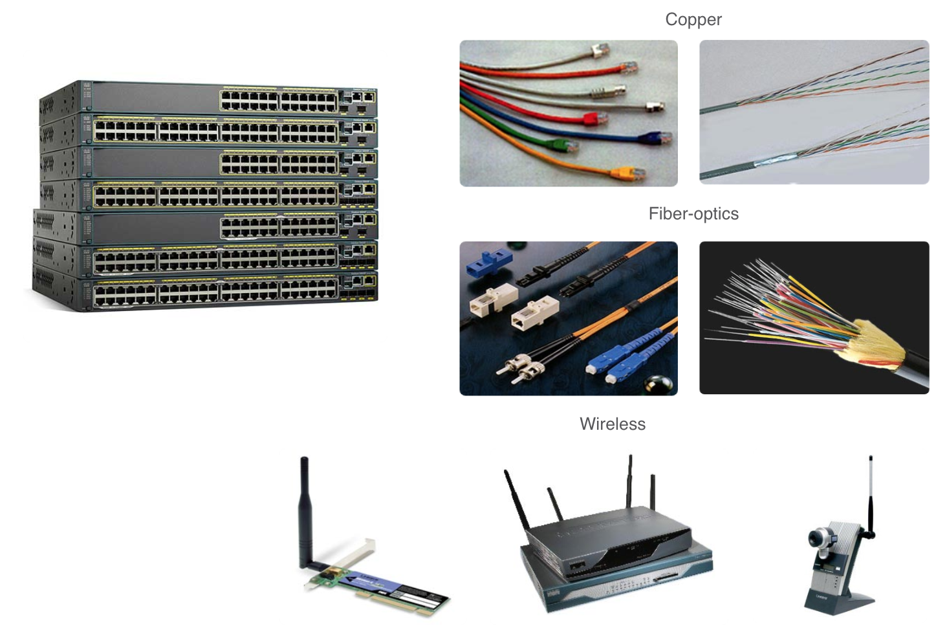
Ports and Addresses Interfaces and Ports
Network communications depend on end user device interfaces, networking device interfaces, and the cables that connect them.
Types of network media include twisted-pair copper cables, fiber-optic cables, coaxial cables, or wireless.
Different types of network media have different features and benefits. Some of the differences between various types of media include:
Distance the media can successfully carry a signal
Environment in which the media is to be installed
Amount of data and the speed at which it must be transmitted
Cost of the media and installation
Notes:
2 – Basic Switch and End Device Configuration
2.6 – Ports and Addresses
2.6.2 – Interfaces and Ports
2.6.3 – Check Your Understanding - Ports and Addresses

Slide 21
2.7 Configure IP Addressing
Notes:
2 – Basic Switch and End Device Configuration
2.7 – Configure IP Addressing

Slide 22
Configure IP Addressing Manual IP Address Configuration for End Devices
End devices on the network need an IP address in order to communicate with other devices on the network.
IPv4 address information can be entered into end devices manually, or automatically using Dynamic Host Configuration Protocol (DHCP).
To manually configure an IPv4 address on a Windows PC, open the Control Panel > Network Sharing Center > Change adapter settings and choose the adapter. Next right-click and select Properties to display the Local Area Connection Properties.
Next, click Properties to open the Internet Protocol Version 4 (TCP/IPv4) Properties window. Then configure the IPv4 address and subnet mask information, and default gateway.
Note: IPv6 addressing and configuration options are similar to IPv4.
Notes:
2 – Basic Switch and End Device Configuration
2.7 – Configure IP Addressing
2.7.1 – Manual IP Address Configuration for End Devices

Slide 23
Configure IP Addressing Automatic IP Address Configuration for End Devices
DHCP enables automatic IPv4 address configuration for every end device that is DHCP-enabled.
End devices are typically by default using DHCP for automatic IPv4 address configuration.
To configure DHCP on a Windows PC, open the Control Panel > Network Sharing Center > Change adapter settings and choose the adapter. Next right-click and select Properties to display the Local Area Connection Properties.
Next, click Properties to open the Internet Protocol Version 4 (TCP/IPv4) Properties window, then select Obtain an IP address automatically and Obtain DNS server address automatically.
Note: IPv6 uses DHCPv6 and SLAAC (Stateless Address Autoconfiguration) for dynamic address allocation.
Notes:
2 – Basic Switch and End Device Configuration
2.7 – Configure IP Addressing
2.7.2 – Automatic IP Address Configuration for End Devices
2.7.3 – Syntax Checker – Verify Windows PC IP Configuration

Slide 24
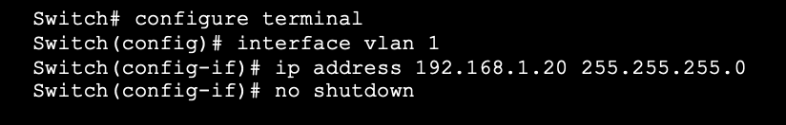
Configure IP Addressing Switch Virtual Interface Configuration
To access the switch remotely, an IP address and a subnet mask must be configured on the SVI.
To configure an SVI on a switch:
Enter the interface vlan 1 command in global configuration mode.
Next assign an IPv4 address using the ip address ip-address subnet-mask command.
Finally, enable the virtual interface using the no shutdown command.
Notes:
2 – Basic Switch and End Device Configuration
2.7 – Configure IP Addressing
2.7.4 – Switch Virtual Interface Configuration
2.7.5 – Syntax Checker – Configure a Switch Virtual interface

Slide 25
Configure IP Addressing Packet Tracer – Implement Basic Connectivity
In this Packet Tracer, you will do the following:
Perform a Basic Configuration on two switches
Configure the PCs
Configure the Switch Management Interface
Notes:
2 – Basic Switch and End Device Configuration
2.7 – Configure IP Addressing
2.7.6 – Packet Tracer – Implement Basic Connectivity

Slide 26
2.8 Verify Connectivity
Notes:
2 – Basic Switch and End Device Configuration
2.8 – Verify Connectivity

Slide 27
Verify Connectivity Video – Test the Interface Assignment
This video will cover the following:
Connect a console cable from the PC to the switch
Use the terminal emulation program and accept the defaults to bring you to the command line
Use enable to enter privileged EXEC mode
Use the global configuration mode and the interface configuration mode to enter the no shutdown command
Notes:
2 – Basic Switch and End Device Configuration
2.8 – Verify Connectivity
2.8.1 – Video - Test the Interface Assignment

Slide 28
Verify Connectivity Video – Test End-to-End Connectivity
This video will cover the use of the ping command to test connectivity on both switches and both PCs.
Notes:
2 – Basic Switch and End Device Configuration
2.8 – Verify Connectivity
2.8.2 – Video - Test End-to-End Connectivity

Slide 29
2.9 Module Practice and Quiz
Notes:
2 – Basic Switch and End Device Configuration
2.9 – Module Practice and Quiz

Slide 30
Module Practice and Quiz Packet Tracer – Basic Switch and End Device Configuration
In this Packet Tracer, you will do the following:
Configure hostnames and IP addresses on two switches
Use Cisco IOS commands to specify or limit access to the device configurations
Use IOS commands to save the running configuration
Configure two host devices with IP addresses
Verify connectivity between the two PC end devices
Notes:
2 – Basic Switch and End Device Configuration
2.9 – Module Practice and Quiz
2.9.1 – Packet Tracer – Basic Switch and End Device Configuration

Slide 31
Module Practice and Quiz Lab – Basic Switch and End Device Configuration
In this lab, you complete the following objectives:
Set Up the Network Topology
Configure PC Hosts
Configure and Verify Basic Switch Settings
Notes:
2 – Basic Switch and End Device Configuration
2.9 – Module Practice and Quiz
2.9.2 – Lab – Basic Switch and End Device Configuration

Slide 32
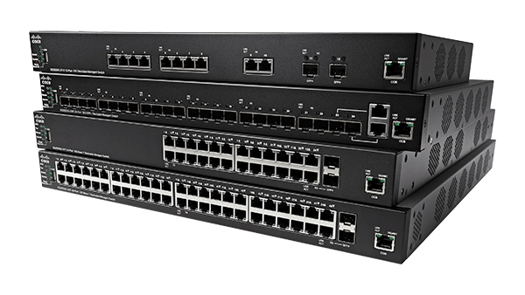
Module Practice and Quiz What did I learn in this module?
All end devices and network devices require an operating system (OS).
Cisco IOS software separates management access into the following two command modes: User EXEC Mode and Privileged EXEC Mode.
Global configuration mode is accessed before other specific configuration modes. From global config mode, the user can enter different subconfiguration modes.
Each IOS command has a specific format or syntax and can only be executed in the appropriate mode.
Basic device configurations- hostname, password, encrypt passwords and banner.
There are two system files that store the device configuration: startup-config and running-config.
IP addresses enable devices to locate one another and establish end-to-end communication on the internet. Each end device on a network must be configured with an IP address.
Notes:
2 – Basic Switch and End Device Configuration
2.9 – Module Practice and Quiz
2.9.3 – What did I learn in this module?
2.9.4 – Module Quiz - Basic Switch and End Device Configuration

Slide 33
Module 2 : Basic Switch and End Device Configuration New Terms and Commands
operating system (OS) CLI GUI shell kernel hardware console Secure Shell (SSH) Telnet terminal emulation programs user EXEC mode privileged EXEC mode | line configuration mode interface configuration mode Enable configure terminal exit end argument keyword command syntax ping traceroute help command ”?” hot keys hostname | console enable secret VTY line show running-config banner motd startup-config running-config reload erase startup-config DHCP switch virtual interface (SVI) ipconfig show ip int brief
Notes:
2 – Basic Switch and End Device Configuration
New Terms and Commands

